Slide 1
Exception Handling and
Reading / Writing Files

Slide 2
Topics
What is an Exception?
Basic error classes in Java
Checked Exceptions vs. Unchecked Exceptions
Exception handling using throws
Reading from files and writing to files
Exception Handling using try/catch

Slide 3
What is an Exception?
An exception is an unexpected error condition that prevents the program from continuing normally.
Programs must be flexible when handling problems.
Rarely do we want to terminate the program abruptly. For example, if the program detects an attempt to read from a non-existent file, we might want to ask the user for another file name.
Exception handling provides an adaptable mechanism for handling such problems.

Slide 4
Examples of Exceptions
Reading from a file that does not exist.
Reading from a file that has corrupt data.
Writing to a file, but the disk is full.
Reading input from the user and the user enters an invalid data type.
Unexpected division by zero
Accessing an array with a subscript (index) that is out of bounds.

Slide 5
Basic Error Classes
Java includes two basic classes of errors: Exception and Error.
Exception
IOException
RuntimeException
ArithmeticException
IndexOutOfBoundsException
ArrayIndexOutOfBoundException
NoSuchElementException
InputMismatchException
etc.
Error: Represents serious errors which your program usually cannot recover.
VirtualMachineError
OutOfMemoryError : insufficient memory
InternalError
etc.

Slide 6
Checked vs. Unchecked Exceptions
There are two categories of Exceptions: Checked and Unchecked.
Unchecked: Means not verified during compile time. These errors typically occur because of poor programming. For example, an array index out of bound.
Checked: Means checked at compile time, such as FileNotFoundException. Code that uses a checked exception will not compile if the catch is not handled. The following code has an unhandled exception

Slide 7
Example of an Exception using an Array.
In the code below, an exception occurs because the array index is out of bounds.
When this happens, an object of the exception class is thrown.
  int [] arr = {11, 9, 6, 5, 8};
  i = 10;
  arr[i] *= 2;

Slide 8
Method 1: Basic Exception Handling using throw.
When an error condition is detected, we can throw an appropriate exception object to handle the condition.
  if (testScore > 100) {
  throw new IllegalArgumentException (“Invalid Test Score”);
  }
  gpa = (testScore + hw + quiz) / 3;
The last line is not executed when the exception is thrown.

Slide 9
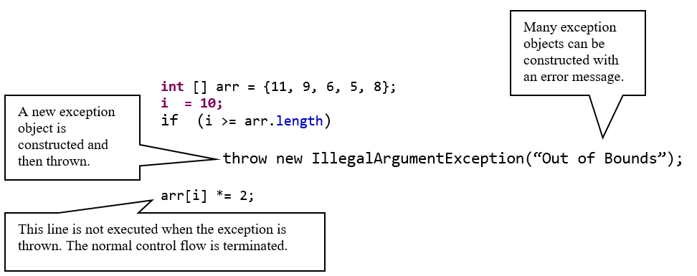
Example 1: Exception Handling using throw.
An error condition is detected
An IllegalArgumentException is throw to handle the error.
Is this a practical example of exception handling?

Slide 10
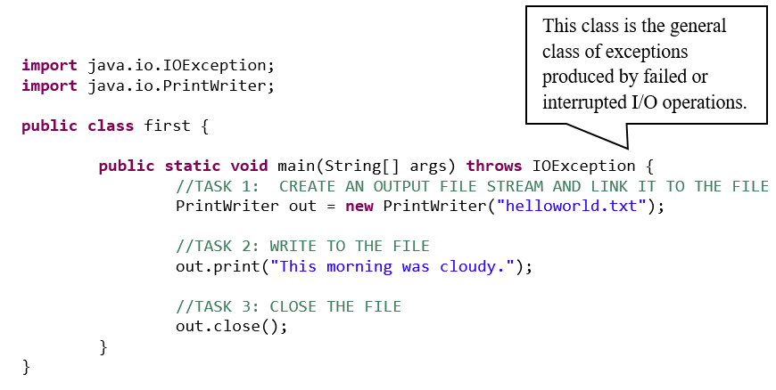
Method 2: Writing to a file
Exception Handling using a throws IOException
.

Slide 11
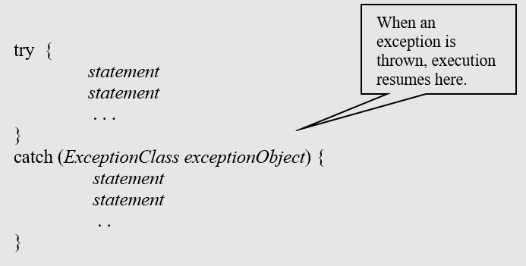
Method 3: Exception Handling using try/catch Blocks
Detect and handle exceptions with the try/catch statements.
Place the statements that can cause an exception inside a try block, and the handler inside a catch clause.
The try block contains one or more statements that may cause an exception.
Each catch clause contains the handler for an exception.

Slide 12
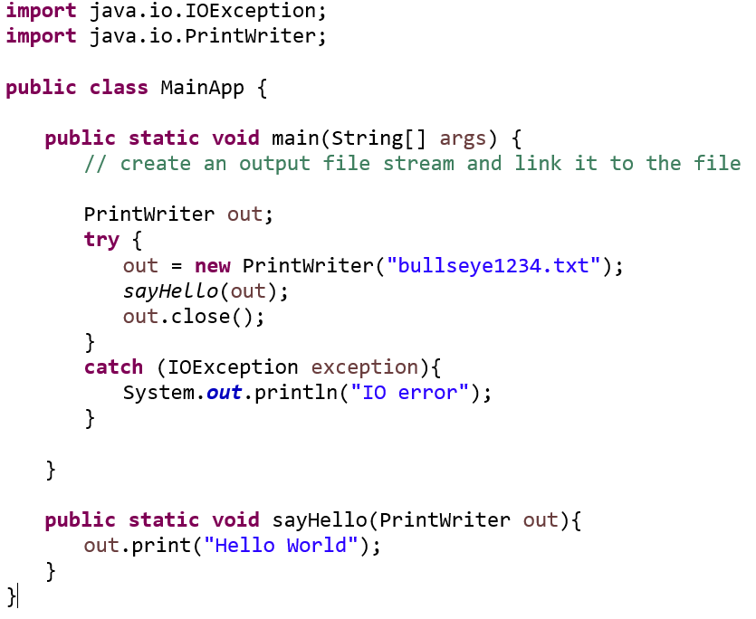
Example 1:
Writing to a file
Exception Handling using a try/catch.

Slide 13
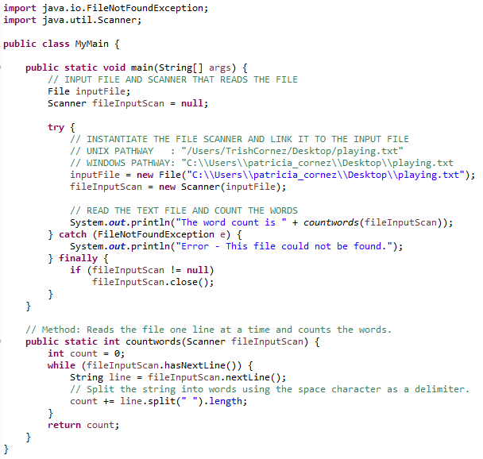
Example 2:
Reading from a file
Exception Handling using a try/catch
Add a finally element to complete any remaining tasks.

Slide 14
Creating an Exception Class
An Exception class can be created by inheriting from java.lang.Exception.
public class MyException extends Exception{
//Required inherited methods are coded here.
}
thow and catch can be used with this class.

Slide 15
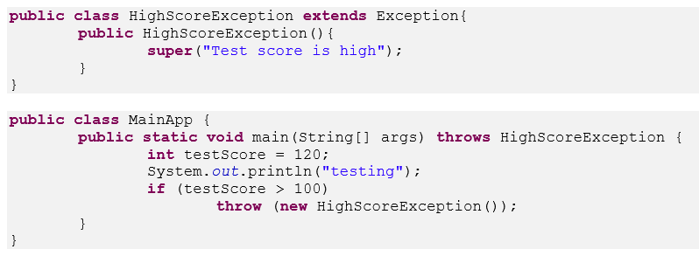
Example :
Create an exception class and test it.

