Slide 1
Basics of OOP
A class is the blueprint of an object.
Example:
A blueprint for a house establishes the design specifications: layout of the rooms dimensions, etc.
A Java class is used to model (establish) the data attributes and behavior of an object.

Slide 2
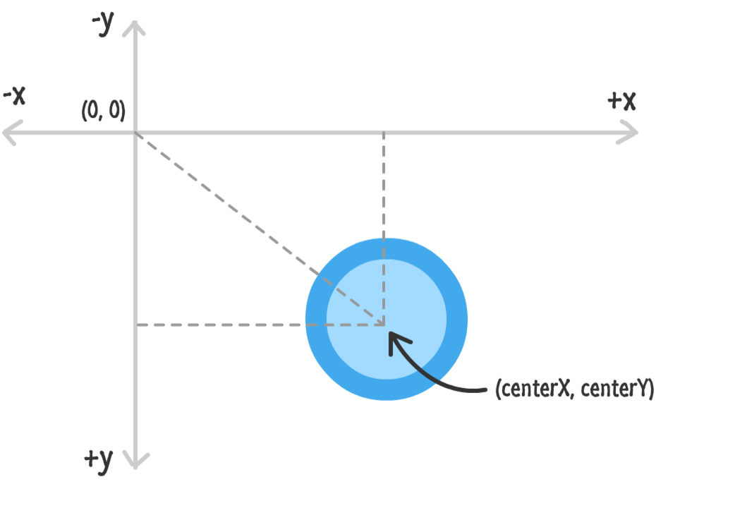
Example: How do we model a circle
drawn on a canvas?

Slide 3
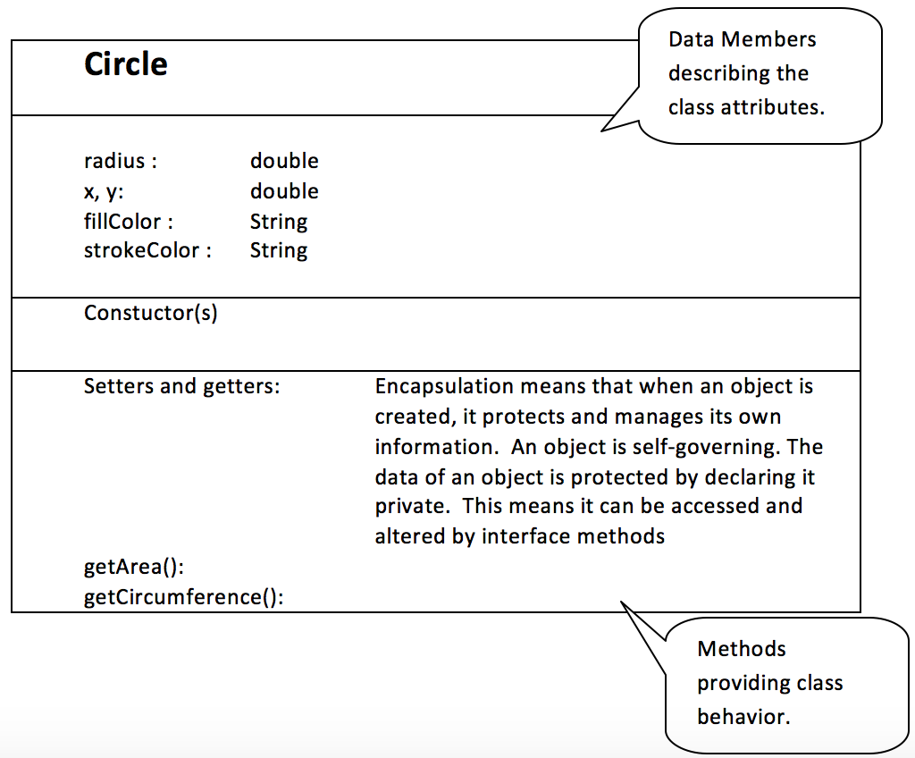

Slide 4
Constructors
A constructor is used to create (instantiate) an object:
Circle c1 = new Circle();
Constructors must have the same name as the class.
A class can have multiple constructors. This is called overloading the constructor. The compiler picks the constructor that matches the constructor arguments.
c1 is a Circle object created
by the constructor of Circle.

Slide 5
public Circle(int x, int y) {
radius = 1;
this.x = x;
this.y = y;
fillColor = “#000000”;
strokeColor = “#000000”;
}
public Circle() {
radius = 1;
x = 1;
y = 1;
fillColor = “#000000”;
strokeColor = “#000000”;
}
Explicit Constructor
Overloaded (same name)
The compiler recognizes the which constructor to use based on the parameter list.
Default Constructor

Slide 6
What happens when there are no constructors?
A default constructor with no arguments is automatically generated.
All data members are initialized to default values.
Default values are 0, false, and null for object instances.

Slide 7
Object References
An object is a reference pointer to a memory location.
Circle c1 = new Circle();
radius
x
c1 y
fillColor
strokeColor

Slide 8
Example of Object References
Consider the following code:
Circle c1 = new Circle(4, 7);
Circle c2 = new Circle(3, 8);
c1 = c2;
The data of c2 is NOT copied to c1. The address of c2 is copied to c1.
Garbage collection mode will locate and reclaim any memory occupied by lost objects.

Slide 9
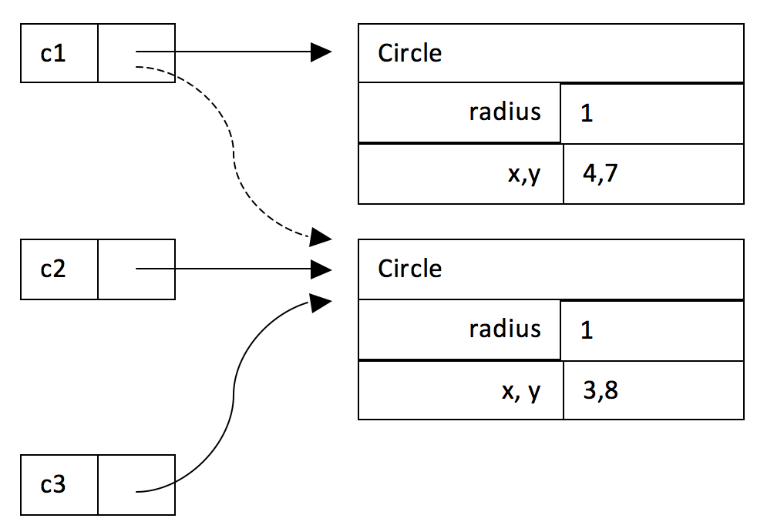
Circle c1 = new Circle(4, 7);
Circle c2 = new Circle(3, 8);
Circle c3 = c2;
c1 = c2;

Slide 10
public , private, static access
public and private are used to allow (public) or hinder(private) access to data members and methods of a class.
static means an element defined by a class belongs to the class, not to an object of the class.
Examples of a static:
Math.PI
Math.abs()
Math.cos()
Math.random()

Slide 11
Example of a static Usage
Static constants can be either public or private. Static variables are usually private.
public class Play {
public static final int CUPCAKE = 999999;
public static String breakfast() {
return "Breakfast is the a morning meal.";
}
}

Slide 12
public class Play {
public static final int CUPCAKE = 999999;
public static String breakfast() {
return "Breakfast is a morning meal.";
}
}
Poor Programming:
Not accessed in a static way. This won’t cause an error, but it is poor programming.
public class TestPlay {
public static void main(String[] args) {
Play play1 = new Play();
System.out.println(play1.CUPCAKE);
System.out.println(play1.breakfast());
System.out.println(Play.CUPCAKE);
System.out.println(Play.breakfast());
}
}
Good Programming:
Accessed in a static way. This is the correct way to call a static method/value.

Slide 13
Dependency and Aggregation (composition) in Classes
The classes in a software application can have various relationships to each other.
Three of the more common relationships are dependency, composition (also called aggregation), and inheritance.
Dependency means that a class uses or relies on another class. For example, the word jumble application relied on the random number generator to randomly select a word to play.
Aggregation (Composition) describes how an object is composed. Some objects are made up of other objects. For example, a car is made up of an engine, wheels, chassis, etc;
Composition is often referred to as a “has a” or “has many” relationship because the objects of the composite “have” objects of the composed class as members.

Slide 14
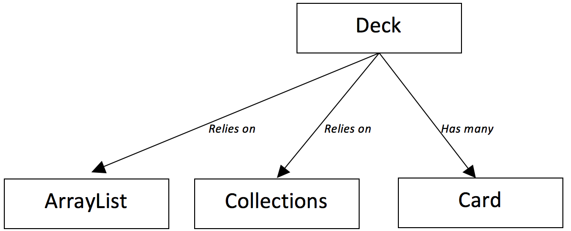
Deck of Cards Example
Notes:
An ArrayList is used to store the collection of cards.
Collections can be used to shuffle the list of cards.

Slide 15
Setters and Getters
Setters and Getters and mutator and accessor methods.
Mutator methods are used to change or set the data of an object:
card1.setRank(2);
Accessor methods do not change the data, but rather access (get) the data of an object:
card1.getRand ();

Slide 16
UML Diagram
UML is a Unified Modeling Language.
Class attributes and methods are indicated in a UML diagram.
A UML diagram divides the class structure into compartments for data members, constructors, and methods.

Slide 17
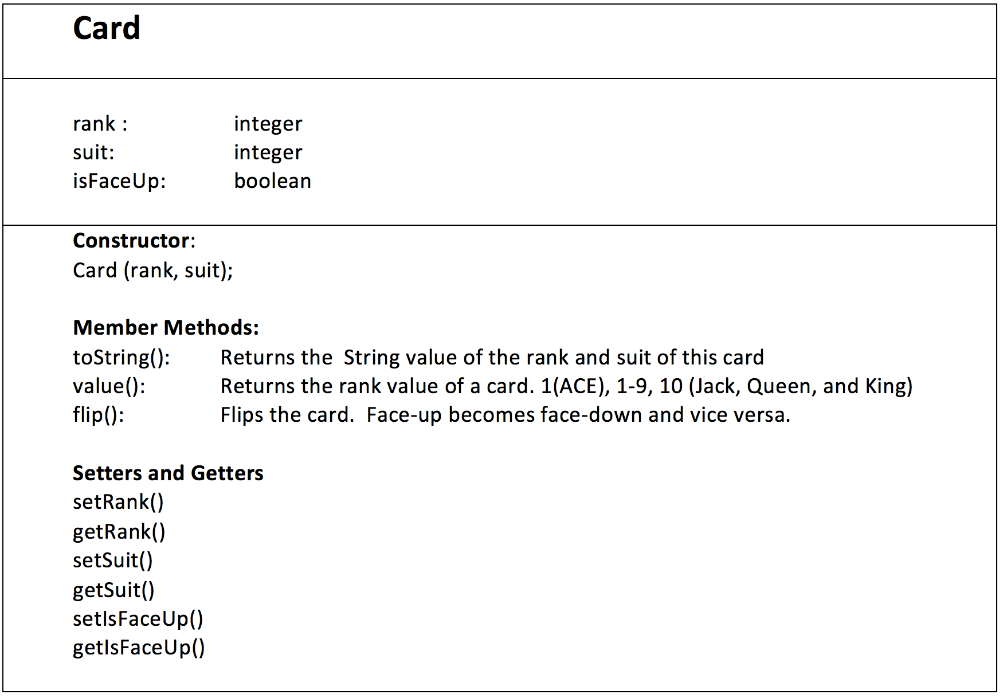

Slide 18
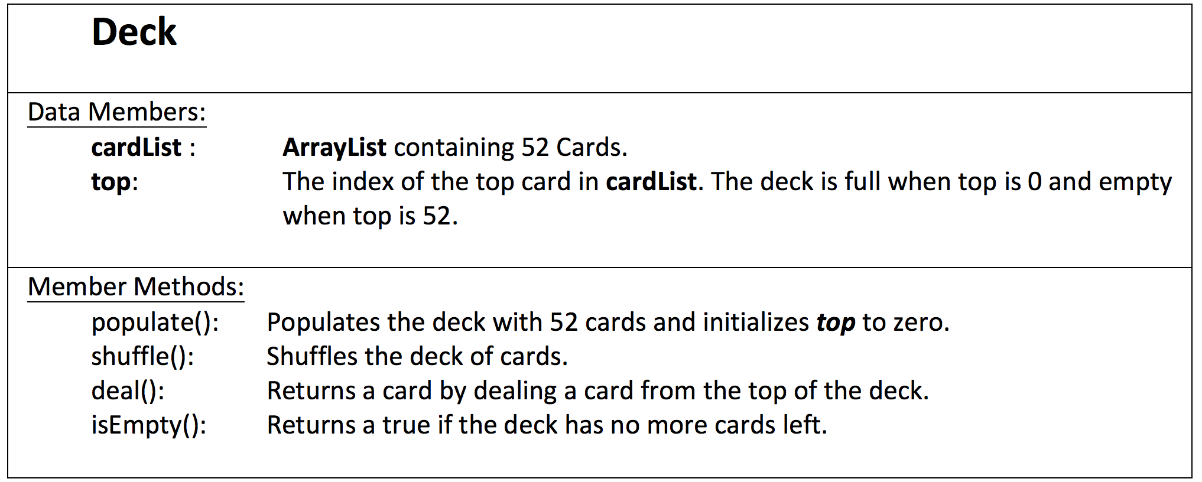

Slide 19
Practice
Create the Deck and Card class.
Create a test class that performs the following:
Create a deck of cards.
Deal cards until there are no more cards left in the deck.
Repopulate and shuffle the deck.
Deal until there are no more cards left in the deck.

