Slide 1
Bootstrap
Topics
What is bootstrap?
Documentation
Media Queries for responsiveness
Usage : Link or download?
Building a responsive web page using bootstrap
Modals: Gootstrap plug-ins for interactive dialog windows.

Slide 2
What is Bootstrap?
Bootstrap is a professionally developed framework from Twitter.
There are dozens of frameworks available, but Bootstrap is currently either one of the most popular or the most popular frameworks available.
Bootstrap provides a framework similar to the one we created earlier in the week. This framework is a responsive and is organized by a grid of rows and columns.
Boostrap also include some advanced functionality
Collection of typography classes
JavaScript modules

Slide 3
Explore Bootstrap Documentation
http://bootstrapdocs.com/v3.0.3/docs/css/
Research the grid system in Bootstrap.
Question: Classes are based on a grid system. What are those classes?
Question: Where are rows placed?
Question: How many columns can be placed in a row?
Question: What Media query breakpoint is used for a small tablet device?

Slide 4
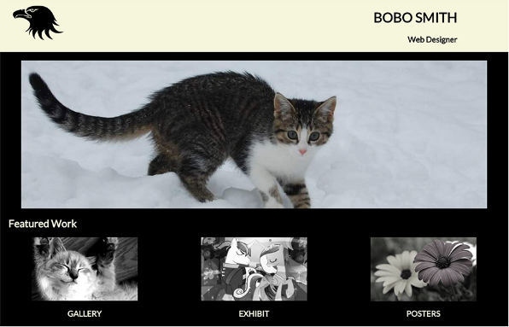
What classes used to create the mockup?

Slide 5
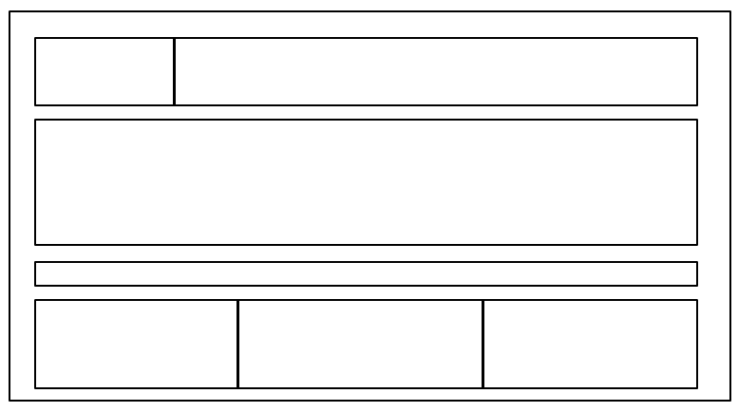
.grid
.row
.col-1
.col-2
…
.col-12
All content was organized in a grid container.
The grid container holds four rows.
Each row contains columns. The first row holds two columns. The second and third rows hold one column. The last row holds three columns.
Bootstrap classes

Slide 6
Bootstrap Usage: Link or Download?
Bootstrap is big!
There are two options for using Bootstrap.
Link the CDN (content delivery network)
Download bootstrap and use it directly from our CSS folder.

Slide 7
Bootstrap Usage: Using a Link to the CSS files
A link CDN (content delivery network) makes it easy to reference Bootstrap files located on another network.
Functionality can be added quickly.
NOTE: We will be using a CDN
<link rel="stylesheet" href="https://maxcdn.bootstrapcdn.com/bootstrap/3.3.6/css/bootstrap.min.css">

Slide 8
Bootstrap Usage: Download Bootstrap
Remember that bootstrap is big!
Bootstrap can be downloaded and used directly from our CSS folder.
Downloading bootstrap is flexible.
Bootstrap allows us to pick and choose specific parts of the framework that we need.

Slide 9
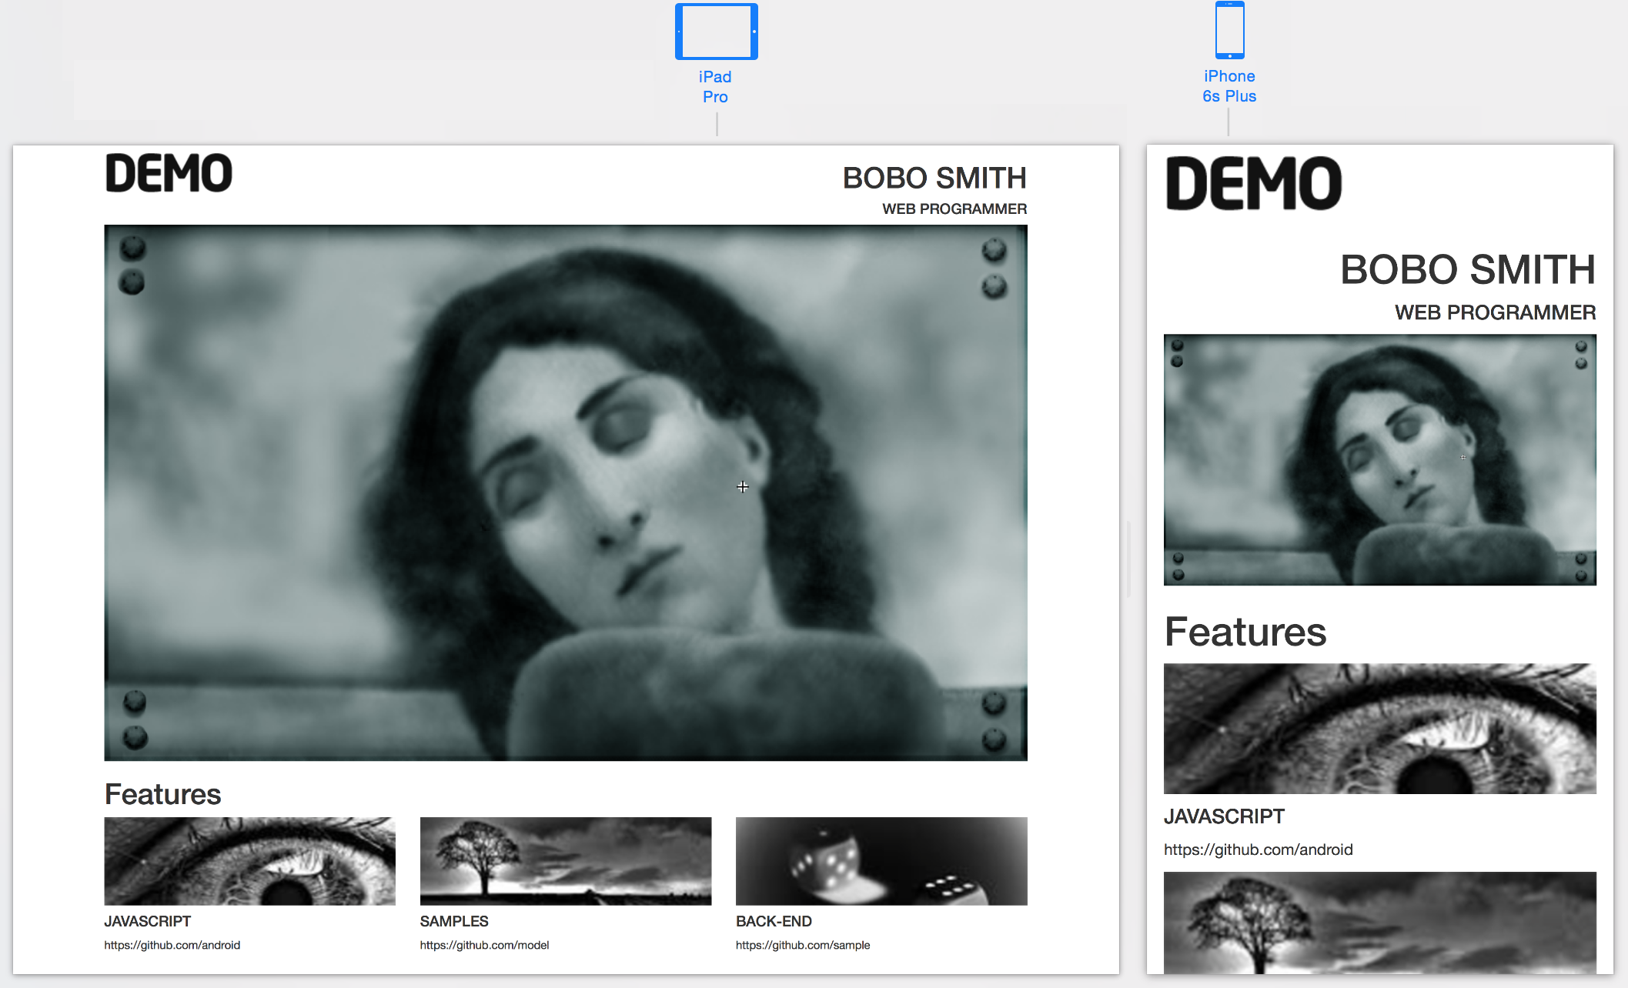
Build a Website using Bootstrap

Slide 10
Task 1: Construct the design by considering the DOM
Examine the mockup and model it using boxes. These boxes will represent the divisions on the page.
Use a <div> container to encompass the entire page.
Subdivide elements by row divisions.
Question:
Which bootstrap classes should you use to wrap the first row of “Feature” items?
Question:
Which class should you use to wrap one single featured item?

Slide 11
Task 2: Build the Webpage using the DOM design and bootstrap
<!DOCTYPE html
<html>
<head>
<title>Lab Bootstrap</title>
<link rel="stylesheet" href="https://maxcdn.bootstrapcdn.com/bootstrap/3.3.6/css/bootstrap.min.css">
</head>
<body>
<div class="container">
</div>
</body>
</html>
Six rows will be placed here.

Slide 12
Task 2 continued…….Rows 1 - 3
<div class="row">
<div class="col-md-6"> <img src="images/demo.gif" alt "logo"> </div>
<div class="col-md-6 text-right text-uppercase">
<h1>Bobo Smith</h1> <h4>Web Programmer</h4>
</div>
</div>
<div class=" row ">
<div class="col-md-12"> <img class="img-responsive" src="images/girl.png" alt="girl"> </div>
</div>
<div class=" row ">
<div class="col-md-12"> <h2>Features</h2> </div>
</div>

Slide 13
Task 2 continued……. Rows 4 - 6
<div class="col-md-4">
<img src="images/bw1.png" alt="bw1" width=100%">
<h4 class="text-uppercase">JavaScript</h4>
<p>https://github.com/android</p>
</div>
<div class="col-md-4">
<img src="images/bw2.png" alt="bs2" width="100%">
<h4 class="text-uppercase">Samples</h4>
<p>https://github.com/model</p>
</div>
<div class="col-md-4">
<img src="images/bw3.png" alt="bs3" width="100%">
<h4 class="text-uppercase">Back-end</h4>
<p>https://github.com/sample</p>
</div>
</div>

Slide 14
Task 3: Test Responsiveness
Make alterations to the images so that they resize automatically. Test the webpage.
Question:
Which class should you apply to images to make them resize automatically?
Research Bootstrap documentation.
Answer:
The correct class is img-responsive.
Example:
<div class=" row ">
<div class="col-md-12">
<img class="img-responsive" src="images/girl.png" alt="girl">
</div>
</div>

Slide 15
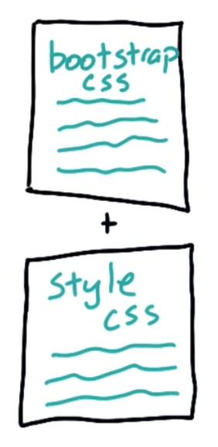
Task 4: Customize with additional CSS
Include styles that are unique within your own page.
Change background color
set margins and padding
Modify font styles (color, typeface, weight)

Slide 16
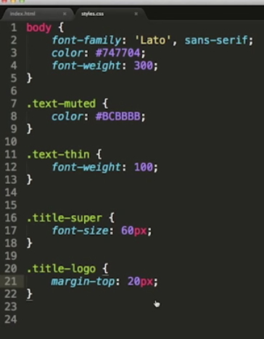
Solution

Slide 17
Modals
Modal are Bootstrap features that uses JavaScript for interactivity.
Typically modal attributes are attached to a button.
An image can also serve as a button. We will attach modals to the images in our portfolio.
A copy and paste solution can be found on the next slide.

Slide 18
<!DOCTYPE html
<html land="en">
<head>
<meta charset="utf-8">
<title>Lab Bootstrap</title>
<link rel="stylesheet" href="https://maxcdn.bootstrapcdn.com/bootstrap/3.3.6/css/bootstrap.min.css">
<script src="https://ajax.googleapis.com/ajax/libs/jquery/1.12.0/jquery.min.js"></script>
<script src="http://maxcdn.bootstrapcdn.com/bootstrap/3.3.6/js/bootstrap.min.js"></script>
</head>
<body>
<div class="container">
<div class="row">
<div class="col-md-6">
<img src="images/demo.gif" alt "logo">
</div>
<div class="col-md-6 text-right text-uppercase">
<h1>Bobo Smith</h1>
<h4>Web Programmer</h4>
</div>
</div>
<div class="row">
<div class="col-md-12"> <img class="img-responsive" src="images/girl.png" alt="girl"> </div>
</div>
<div class="row">
<div class="col-md-12"><h1>Features</h1> </div>
</div>
<div class="row">
<div class="col-md-4">
<img src="images/bw1.png" alt="bw1" width=100%" data-toggle="modal" data-target="#project1">
<h4 class="text-uppercase">JavaScript</h4> <p>https://github.com/android</p>
</div>
<div class="col-md-4">
<img src="images/bw2.png" alt="bs2" width="100%">
<h4 class="text-uppercase">Samples</h4><p>https://github.com/model</p>
</div>
<div class="col-md-4">
<img src="images/bw3.png" alt="bs3" width="100%">
<h4 class="text-uppercase">Back-end</h4> <p>https://github.com/sample</p>
</div>
</div>
<!-- MODAL FOR FEATURE PROJECT 1 -->
<div class="modal fade" id="project1" tabindex="-1" role="dialog" aria-labelledby="myModalLabel" aria-hidden="true">
<div class="modal-dialog">
<div class="modal-content">
<div class="modal-header">
<h4 class="modal-title" id="myModalLabel">Favorite feature Page</h4>
</div>
<div class="modal-body">
<img class="img-responsive" src="images/bw1.png">
this was dkdkd there are no places to go.
I must turn back now before it all disappears before my
eyes. The fries are cold, but the coffee is strong and hot.
I will survive.
</div>
<div class="modal-footer">
<button type="button" class="btn btn-default" data-dismiss="modal">Close</button>
</div>
</div>
</div>
</div>
</div>
</body>
</html>

Slide 19
Bootstrap Tradeoffs
There is a trade off between using an established framework like Bootstrap or using your own framework.
Bootstrap has a lot of features – You can build a tremendous amount with Bootstrap.
However, when you want to do things Bootstrap doesn't support, you may wish to construct your own.
There is a lot of freedom when implementing your own framework.

