Slide 1
SFTP and UNIX
TOPICS
Exploring your Web Hosting Site
FTP
UNIX
Upload an index page to your web hosting site

Slide 2
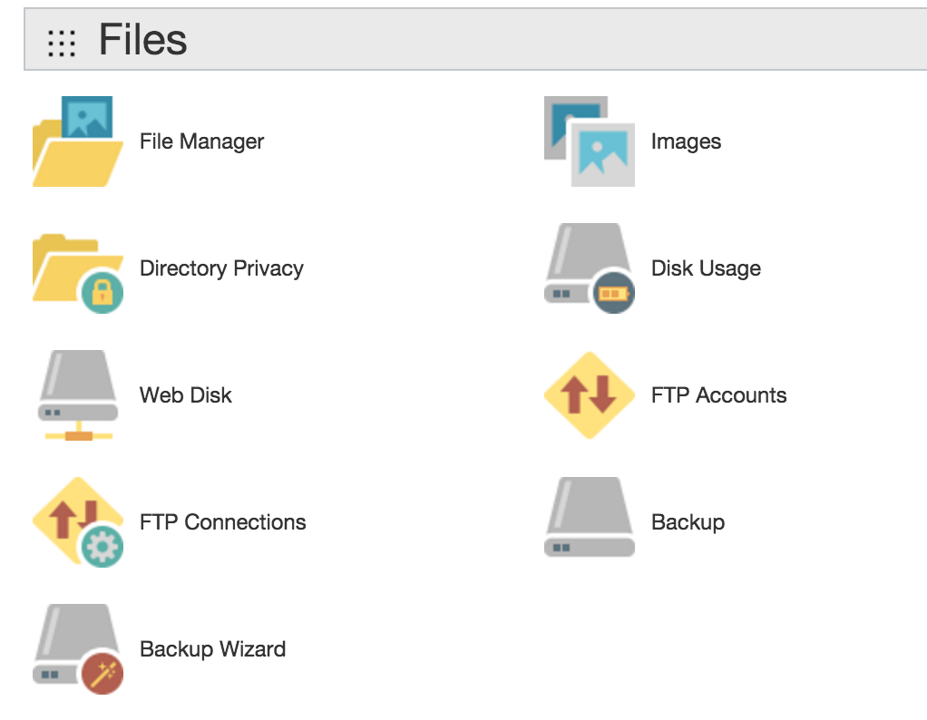
Working with Files on the Web Hosting Site
File Manager allows you to view the files in your site as well as to upload new files and modify existing files.
Web Disk allows you to drag and drop files to your hosting account.
Web Disks Subdomains are relative to your account’s home directory.

Slide 3
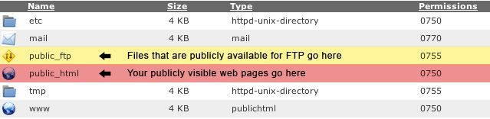
Files and Directories on the Host Server
public_html is the main directory that we will be using.
The public_html directory contains the files for your site. Files in public_html and any subdirectories of public_html will be viewable by anyone on the internet.
When a user views a directory in your public_html area, they will see the index page for that directory.
When creating your index page, you should use one of the following names (the first one found will be shown if the visitor doesn't specify a page in the URL):
index.html
index.htm
Default.html
Default.htm
home.html
welcome.html

Slide 4
SFTP: Secure File Transfer Protocol
SFTP enables files to be transferred from one machine on a network to another.
SFTP is useful as it allows you to store or retrieve files from any computer.
Many different SFTP tools are available, but the first and most commonly available is the text mode FTP which can always be found on Unix systems, or in 'DOS' under Windows.
Terminal (Mac)
Command Prompt (Windows)

Slide 5
BASIC UNIX Commands
On the following slides are the basic UNIX commands that will allow you to successfully to log on to your host web server, navigate the directories, upload and download files (transfer files) and log off.
NOTE:
The contents of [square brackets] are customizable
[filespec] means either a full file name (ie. 'list.txt') or a filename with wildcards
* is a wild card. For example, 'l*' means all files beginning with 'l', and '*.txt' means all files ending with '.txt’
Type a question mark (?) if you need a list of UNIX commands.

Slide 6
UNIX Command for (logging on) Connecting to the Web Host Server
sftp [username]@[host domain name]
Connects to [sitename]
Login: requires password

Slide 7
UNIX Commands for Navigating Directories
cd [directory]
Allows you to change directories. Use quotes for names that have spaces. You can also use cd.. to go up one level in a directory.
lcd
Changes your local directory (the directory from which you started 'ftp' from). Use lcd to go up one level in a directory.
pwd
Print (display to the screen) the directory you are currently working in.
ls [filespec]
Lists the details of the files and directories.
Example output:
-rw-rw-r-- 1 2066 ftp-game 234868 Jan 2 2018 list.txt
NOTES:
r represents read permission, w represents write permission
The first group of rw permissions is defined for the owner of the file.
The second group of rw permissions is defined for the group that the own belongs to.
The last group of rw permissions is defined for users. Note that users have read permission only.
234868 is the file size.
Last modified on January 2nd 2018.

Slide 8
UNIX Commands for Uploading and Downloading Files
bin
Changes to binary mode. This mode is used when transferring image files, or non-text files. Binary mode will work for all files.
ascii
The default mode is 'ascii’. This mode will only work for text files. It is important to make sure you type 'bin' before you upload or download an image. Otherwise, you will get garbage.
put [file]
Uploads [filename] from your current local directory. To upload a file, you must be in a directory you are allowed to upload into. .
mput [filespec]
Uploads multiple files matching [filespec]
get [file]
Downloads [filename] and type 'y' when asked to confirm.
mget [files]
Multiple download of [filespec] files

Slide 9
UNIX Command for Logging Out of SFTP
bye
This command will log you off and close the SFTP connection.

Slide 10
Practice: Upload your index.html page to your web host server.
Step 1: Load the command line (Terminal or Command Prompt) and SFTP to your web domain
>sftp [username]@[ host domain name] You will be prompted for your password.
Step 2: You are now 'in' the site. Examine the directories. View your directories by typing ls.
Step 3: Change directory to public_html by typing cd public_html
Step 4: Create a directory called stupidStuff. Verify it was created.
Step 5: Delete stupidStuff. Verify.
Step 6: Use put to upload your index.html page.
Step 7: Use del to Delete home.html
Step 8: Logout of the FTP session by typing bye
Step 9: Load Chrome and verify your webpage has been updated.

